Slide 1
Matplotlib
Day
The Data Bootcamp |
December 21, 2017

Slide 2
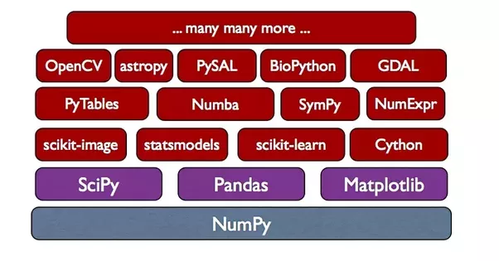
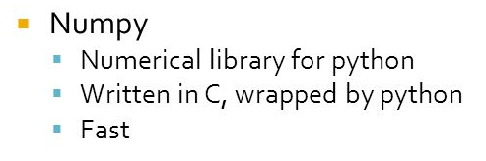
Notes:
Panda’s dataframes are numpy arrays

Slide 3
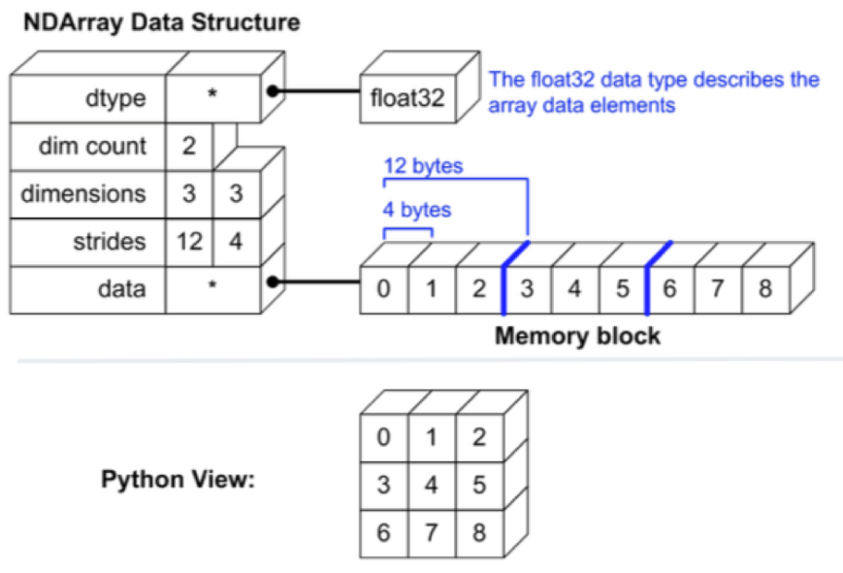
Numpy
NumPy is the fundamental package for scientific computing in Python. It is a Python library that provides a multidimensional array object, various derived objects (such as masked arrays and matrices), and an assortment of routines for fast operations on arrays.
At the core of the NumPy package, is the ndarray object. This encapsulates n-dimensional arrays of homogeneous data types, with many operations being performed in compiled code for performance.

Slide 4
Break

